Slide 1
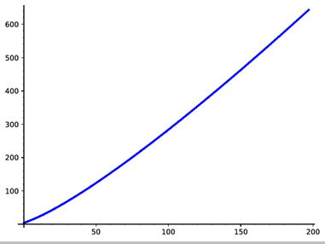
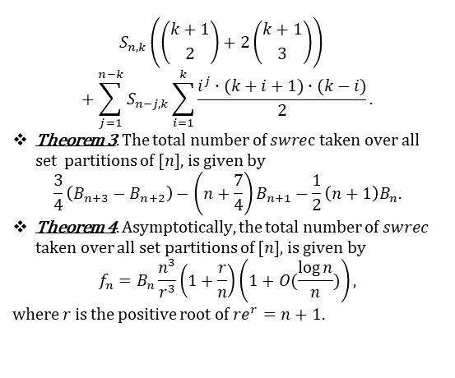
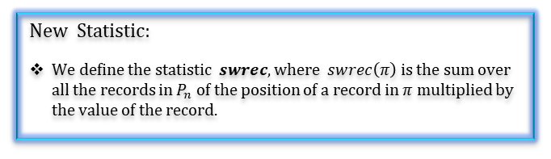
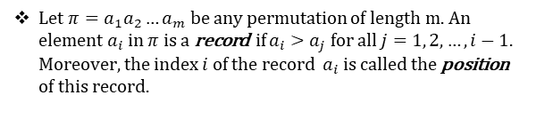

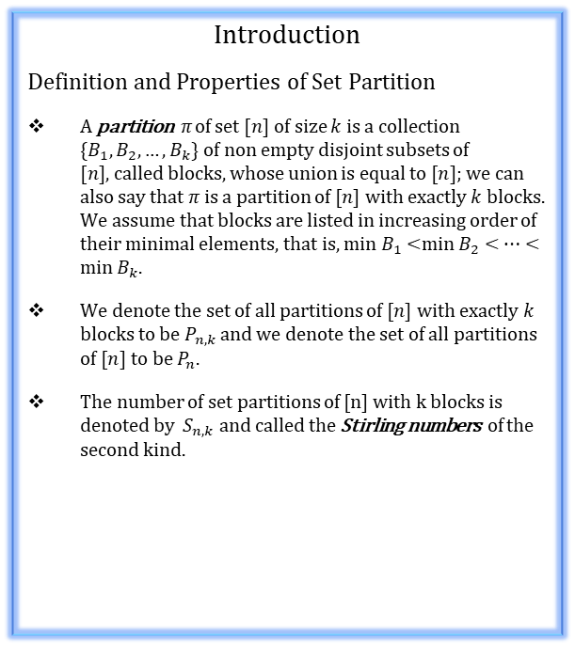

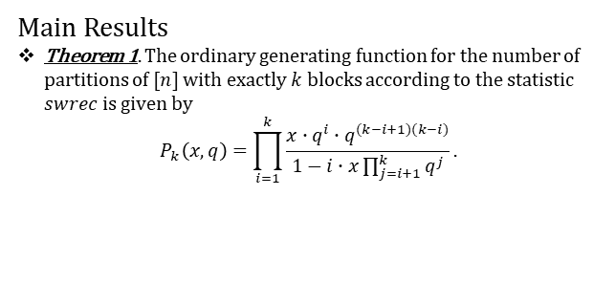
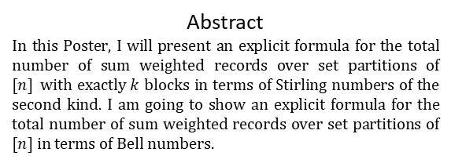
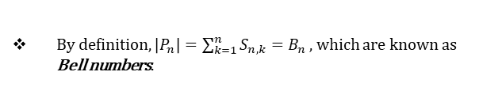
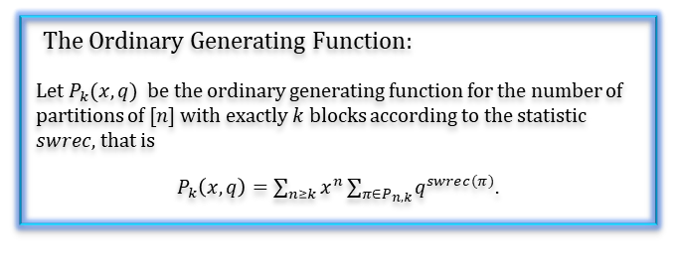


Bell numbers, Stirling numbers, and set partitions.
W. Asakly, University of Haifa.
Abstract
In this Poster, I will present an explicit formula for the total number of sum weighted records over set partitions of $[n]$with exactly $k$ blocks in terms of Stirling numbers of the second kind. I am going to show an explicit formula for the total number of sum weighted records over set partitions of $[n]$in terms of Bell numbers.
Important Statistic:
$$S_{n,k}\left(\left({k+1 \atop 2}\right)+2\left({k+1 \atop 3}\right)\right) +\sum_{j=1}^{n−k}{S_{n−j,k}\sum_{i=1}^{k}{\frac{i^{j}∙(k+i+1)∙(k−i)}{2}}}.$$
Theorem 3. The total number of $swre$c taken over all set partitions of $[n]$, is given by
$$\frac{3}{4}\left(B_{n+3}−B_{n+2}\right)−\left(n+\frac{7}{4}\right)B_{n+1}−\frac{1}{2}\left(n+1\right)B_{n}.$$
Theorem 4. Asymptotically, the total number of $swrec$ taken over all set partitions of $[n]$, is given by
$$f_{n}=B_{n}\frac{n^{3}}{r^{3}}\left(1+\frac{r}{n}\right)\left(1+O(\frac{\log{n}}{n})\right),$$
where $r$ is the positive root of $re^{r}=n+1.$
Let $π=a_{1}a_{2}…a_{m}$ be any permutation of length m. An element $a_{i}$ in $π$ is a record if $a_{i}>a_{j}$ for all $j=1, 2, …,i−1$. Moreover, the index $i$ of the record $a_{i}$ is called the position of this record.
We define a record in partition $π$by considering the record in the canonical form of $π$.
Introduction
Definition and Properties of Set Partition
A partition $π$ of set $[n]$of size $k$ is a collection $\{B_{1}, B_{2}, …,B_{k}\}$ of non empty disjoint subsets of $[n],$called blocks, whose union is equal to $[n]$; we can also say that $π$is a partition of $[n]$with exactly $k$ blocks. We assume that blocks are listed in increasing order of their minimal elements, that is, min $B_{1}$<min $B_{2}$ < $⋯<\min{B_{k}}$.
We denote the set of all partitions of $[n]$with exactly $k$ blocks to be $P_{n,k}$ and we denote the set of all partitions of $[n]$to be $P_{n}$.
The number of set partitions of [n] with k blocks is denoted by $S_{n,k}$ and called the Stirling numbers of the second kind.
New Statistic:
We define the statistic $swrec$, where $swrec\left(π\right)$ is the sum over all the records in $P_{n}$of the position of a record in $π$ multiplied by the value of the record.
The Ordinary Generating Function:
Let $P_{k}(x,q)$ be the ordinary generating function for the number of partitions of $[n]$ with exactly $k$ blocks according to the statistic $swrec$, that is
$P_{k}\left(x,q\right)=\sum_{n≥k}{x^{n}\sum_{π∈P_{n,k}}{q^{swrec(π)}}}$.
The graph of $\log\left(f_{n}\right):$
Main Results
Theorem 1. The ordinary generating function for the number of partitions of $[n]$ with exactly $k$ blocks according to the statistic $swrec$ is given by
$$P_{k}\left(x,q\right)=\prod_{i=1}^{k}{\frac{x∙q^{i}∙q^{(k−i+1)(k−i)}}{1−i∙x\prod_{j=i+1}^{k}{q^{j}}}.}$$
By definition, $\left|P_{n}\right|=\sum_{k=1}^{n}{S_{n,k}=B_{n}},$ which are known as Bell numbers.
  Any partition $π$can be written as $π_{1}π_{2}…π_{n}$, where $i∈B_{π_{i}}$ for all $i$, and this form is called the canonical sequential form.
Acknowledgement: The research of the author
was supported by the Ministry of Science and Technology,
Israel.
Theorem 2. The total number of $swrec$ taken over all set partitions of $\left[n\right]$ with exactly $k$ blocks, is given by

