Slide 1
Testing for Forbidden Patterns in Permutations
Gil Laufer
Haifa University, CS Dept.
Joint work with Yuri Rabinovich

Slide 2
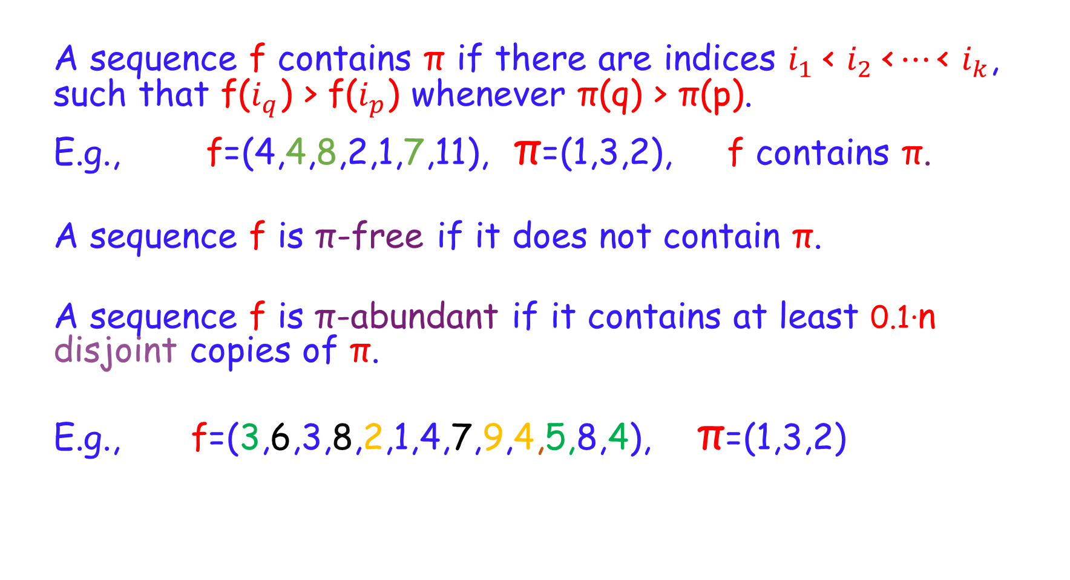
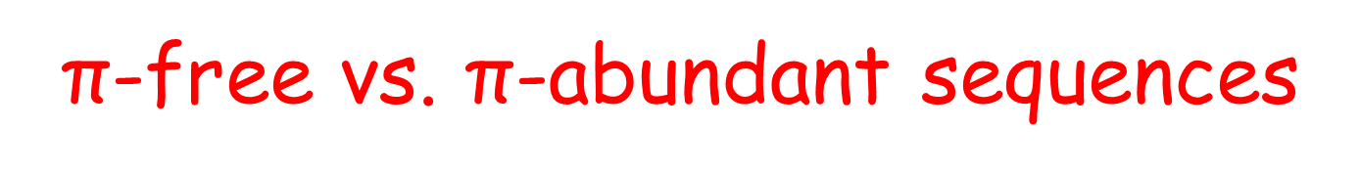
$\text{π}$-free vs. $\text{π}$-abundant sequences
  A sequence f contains π if there are indices $i_{1} \text{<} i_{2} \text{<}…\text{<} i_{k}$, such that f($i_{q}$) > f($i_{p}$) whenever π(q) > π(p).
  E.g., f=(4,4,8,2,1,7,11), π=(1,3,2), f contains π.
  A sequence f is π-free if it does not contain π.
  A sequence f is π-abundant if it contains at least 0.1·n disjoint copies of π.
  E.g., f=(3,6,3,8,2,1,4,7,9,4,5,8,4), π=(1,3,2)

Slide 3
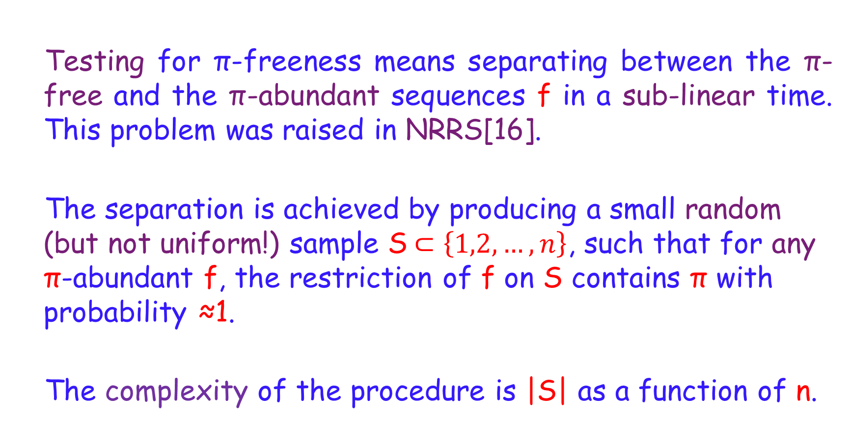
Testing for π-freeness
  Testing for π-freeness means separating between the π-free and the π-abundant sequences f in a sub-linear time. This problem was raised in NRRS[16].
  The separation is achieved by producing a small random (but not uniform!) sample S$⊂\left\{1,2,…,n\right\}$, such that for any π-abundant f, the restriction of f on S contains π with probability ≈1.
  The complexity of the procedure is |S| as a function of n.

Slide 4
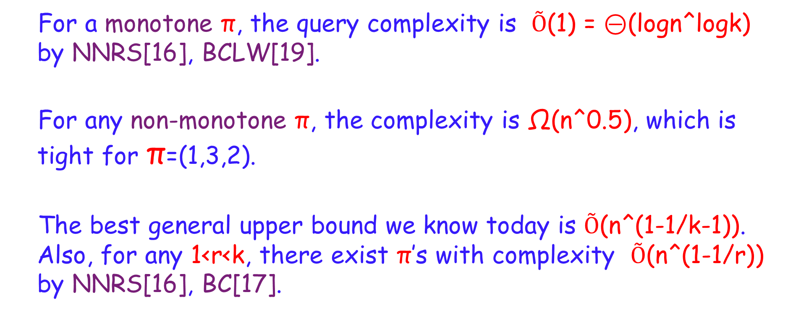
How the Complexity Depends on π
  For a monotone π, the query complexity is $Õ$(1) = ⊝(logn^logk) by NNRS[16], BCLW[19].
  For any non-monotone π, the complexity is Ω($\text{n}\text{^}\text{0.5}$), which is tight for π=(1,3,2).
  The best general upper bound we know today is $Õ\text{(}$n^(1-1/k-1)). Also, for any 1<r<k, there exist π’s with complexity $Õ\text{(}$n^(1-1/r)) by NNRS[16], BC[17].

Slide 5
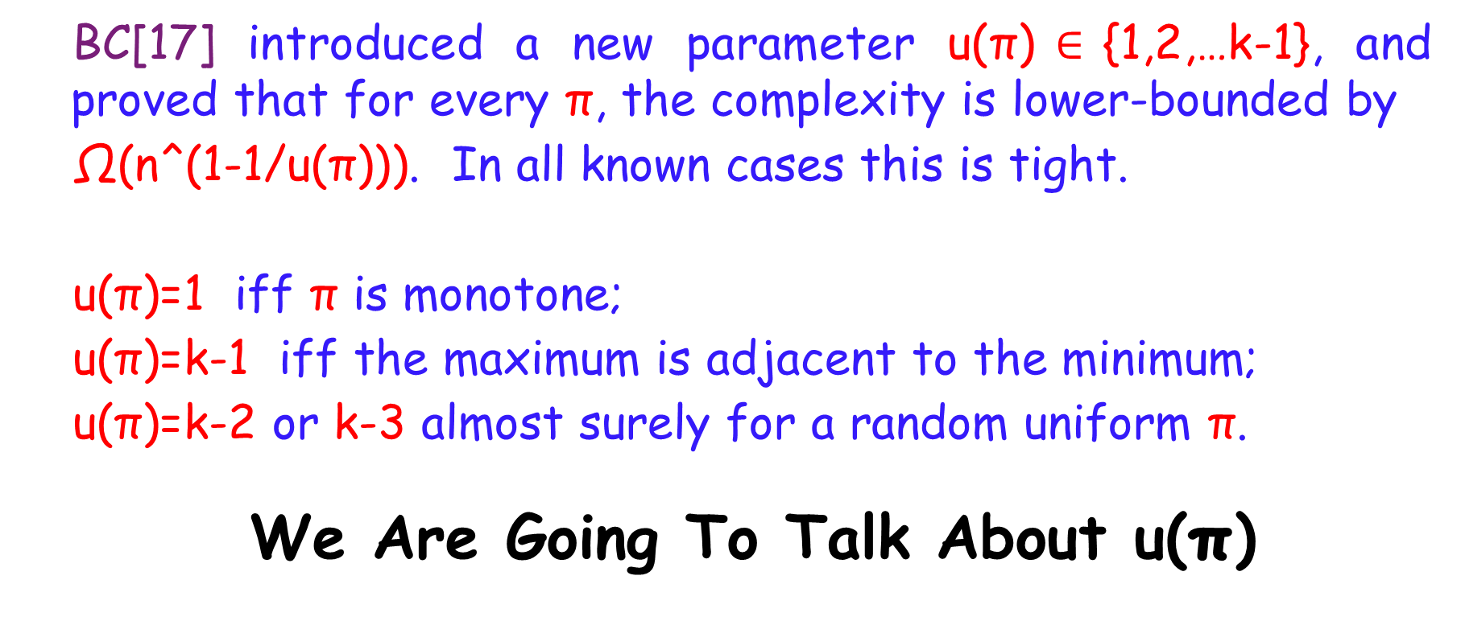
How the Complexity Depends on π:
The Parameter u(π)
  BC[17] introduced a new parameter u(π)$∈${1,2,…k-1}, and proved that for every π, the complexity is lower-bounded by
  $\text{Ω}\text{(}$n^(1-1/u(π))). In all known cases this is tight.
  u(π)=1 iff π is monotone;
  u(π)=k-1 iff the maximum is adjacent to the minimum;
  u(π)=k-2 or k-3 almost surely for a random uniform π.
  We Are Going To Talk About u(π)

Slide 6
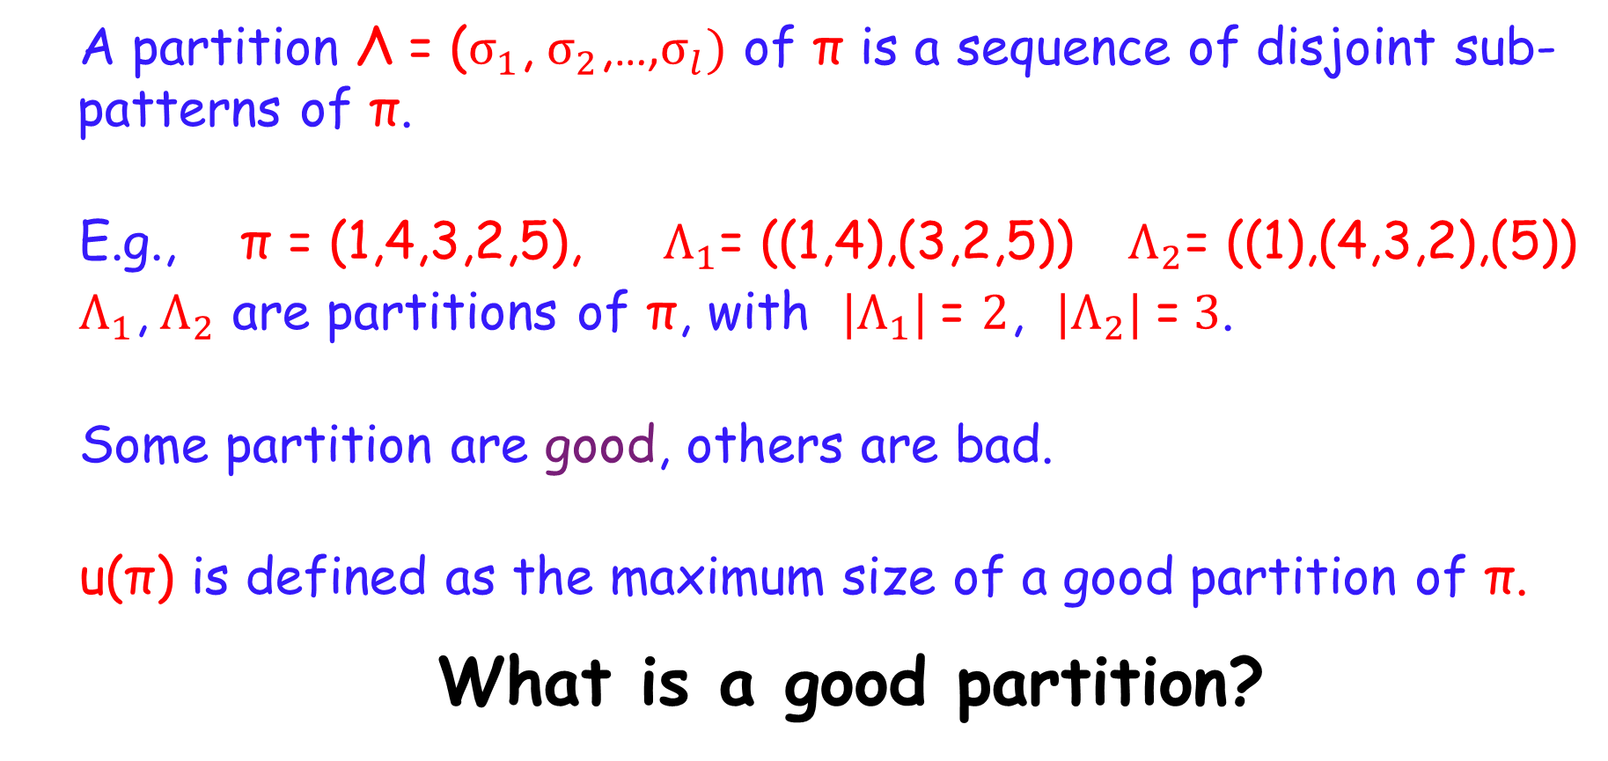
Towards the definition of u(π)
  A partition Λ = ($σ_{1}$, $σ_{2}$,…,$σ_{l})$ of π is a sequence of disjoint sub-patterns of π.
  E.g., π = (1,4,3,2,5), $Λ_{1}$= ((1,4),(3,2,5)) ${ Λ}_{2}$= ((1),(4,3,2),(5))
  $Λ_{1}$, $Λ_{2}$ are partitions of π, with ${|Λ}_{1}| \text{=} 2$, ${|Λ}_{2}| \text{=} 3$.
  Some partition are good, others are bad.
  u(π) is defined as the maximum size of a good partition of π.
  What is a good partition?

Slide 7
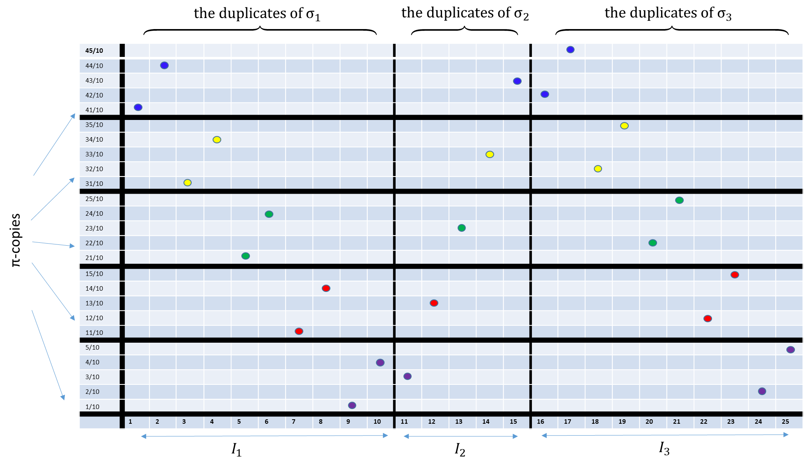
The permutation Π for π = (1,4,3,2,5), $Λ$=((1,4), (3), (2,5))

Slide 8
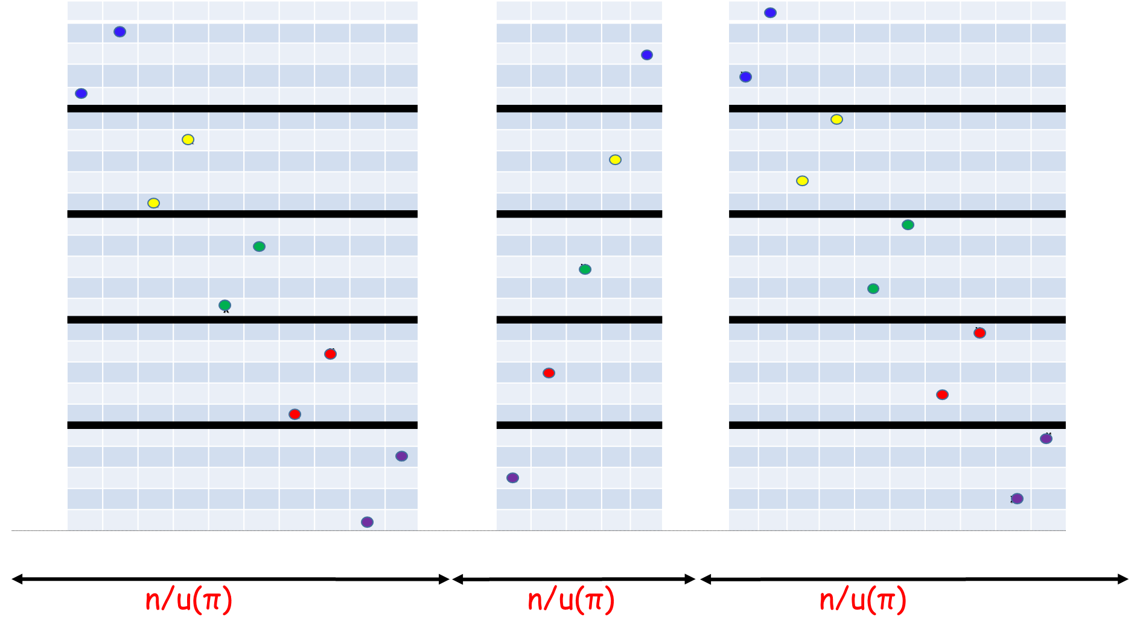
Some intuition about the lower bound: a reduction

Slide 9
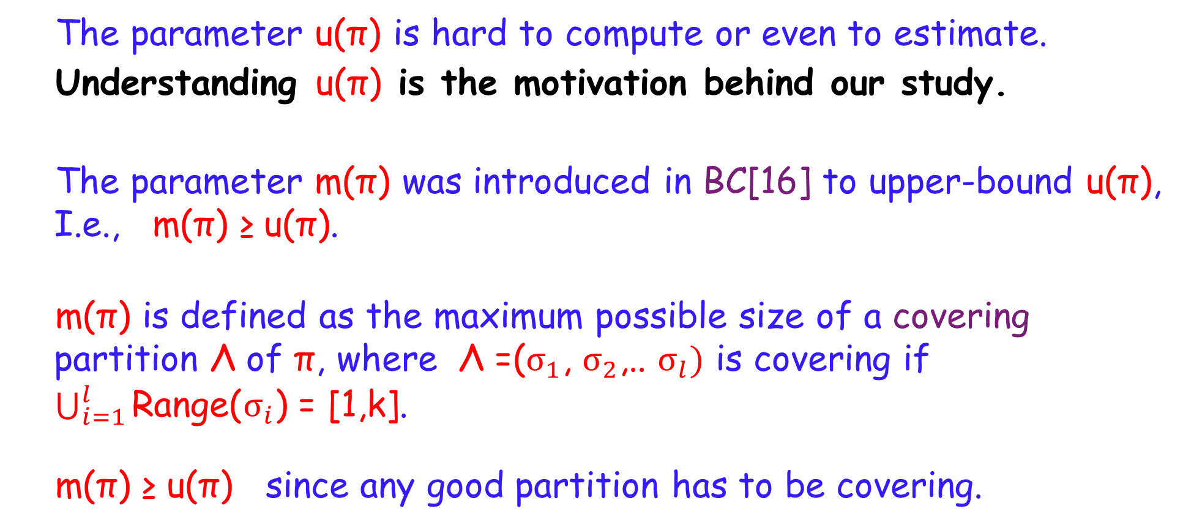
The parameter m(π)
  The parameter u(π) is hard to compute or even to estimate.
  Understanding u(π) is the motivation behind our study.
  The parameter m(π) was introduced in BC[16] to upper-bound u(π), I.e., m(π) ≥ u(π).
  m(π) is defined as the maximum possible size of a covering partition Λ of π, where Λ =($σ_{1}$, $σ_{2}$,.. $σ_{l})$ is covering if $\bigcup_{i=1}^{l}{\text{Range}\text{(}σ_{i}\text{)}}$ = [1,k].
  m(π) ≥ u(π) since any good partition has to be covering.

Slide 10
  π =(1,2,4,6,10,3,8,7,5,9,11)
  Find a y-covering set of x-intervals of a minimum total size.

Slide 11
  π =(1,2,4,6,10,3,8,7,5,9,11)
  Λ=((1,2,4),(6),(10,3),(8),(7),(5),(9,11)) m(π)=7

Slide 12
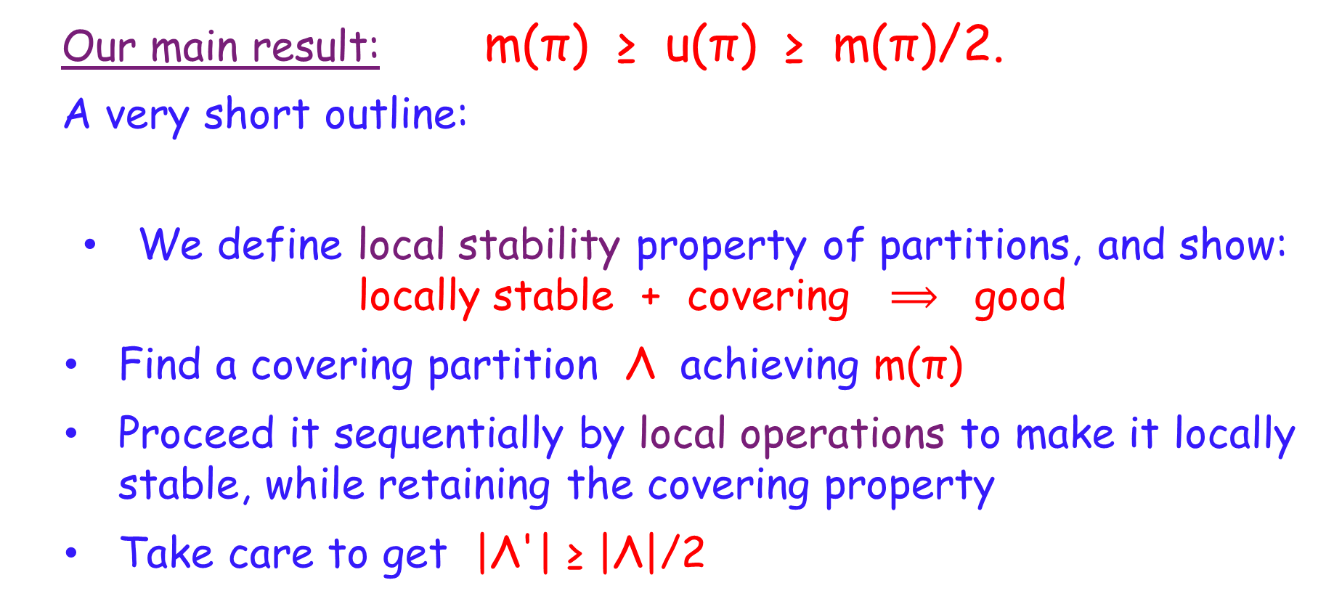
u(π) vs. m(π)
Our main result: m(π) ≥ u(π) ≥ m(π)/2.
A very short outline:
  We define local stability property of partitions, and show: locally stable + covering $⟹$ good
  Find a covering partition Λ achieving m(π)
  Proceed it sequentially by local operations to make it locally stable, while retaining the covering property
  Take care to get |Λ'| ≥ |Λ|/2

Slide 13
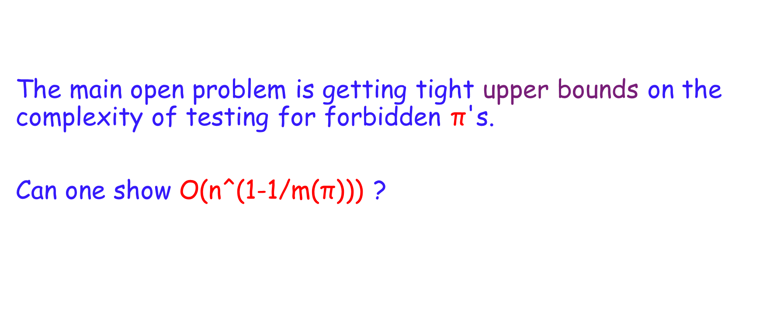
Open Problems
The main open problem is getting tight upper bounds on the complexity of testing for forbidden π's.
Can one show O$\text{(}$n^(1-1/m(π))) ?

Slide 14

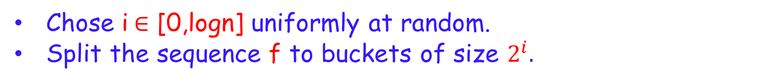





Appendix : Testing for forbidden π=(1,2)
Chose i$∈$ [0,logn] uniformly at random.
Split the sequence f to buckets of size $2^{i}.$
$$2^{i}$$
$$2^{i}$$
$$2^{i}$$
$$2^{i}$$
$$2^{i}$$
$$2^{i}$$
$$2^{i}$$
$$2^{i}$$
Choose two random consecutive buckets, and choose a random element from each.
$$2^{i}$$
$$2^{i}$$
Pr[ getting (1,2) | f is (1,2)-abundant) ] ≥ 1/(logn)^2

